Slide 1
SHRUTHI S
B.Tech : AI&DS
Panimalar Institute of Technology
au211521243149
3/21/2024 Annual Review

Slide 2
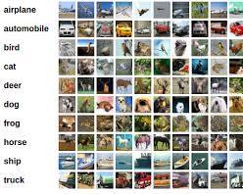
PROJECT TITLE
“Exploring Gen-AI(GAN) for CIFAR-10 image synthesis.”
3/21/2024 Annual Review

Slide 3


AGENDA
PROBLEM STATEMENT
PROJECT OVERVIEW
END USERS
SOLUTION AND ITS VALUE PROPOSITION
WOW IN THE SOLUTION
MODELLING
RESULT
3/21/2024 Annual Review

Slide 4

PROBLEM STATEMENT
"Utilizing Generative Adversarial Networks (GANs) to generate lifelike images within the CIFAR-10 dataset. This project seeks to develop a sophisticated AI model capable of synthesizing images indistinguishable from real photographs. By harnessing advanced deep learning techniques, the aim is to push the boundaries of image synthesis and pave the way for innovative applications in computer vision and artificial intelligence."
3/21/2024 Annual Review

Slide 5

PROJECT OVERVIEW
"This endeavor involves the implementation of Generative Adversarial Networks (GANs) to generate photorealistic images within the CIFAR-10 dataset. Through intricate model architecture and extensive training, the goal is to produce synthetic images that closely resemble real-world photographs. By exploring the capabilities of GANs in image synthesis, this project aims to advance the field of computer vision and enable applications such as data augmentation, image enhancement, and content creation. Leveraging cutting-edge deep learning techniques, the project seeks to address challenges in generating high-quality images and unlock new opportunities for AI-driven image generation in diverse domains."
3/21/2024 Annual Review

Slide 6

WHO ARE THE END USERS?
"The primary beneficiaries of this project include researchers, developers, and practitioners in the fields of computer vision, artificial intelligence, and image processing. Additionally, professionals and enthusiasts involved in applications such as image editing, content creation, and data augmentation can leverage the generated images. Industries spanning from entertainment and advertising to healthcare and robotics may also find value in the advanced image synthesis capabilities provided by the project. Ultimately, the end users encompass a diverse range of individuals and organizations seeking innovative solutions for image generation and manipulation."
3/21/2024 Annual Review

Slide 7

YOUR SOLUTION AND ITS VALUE PROPOSITION
"Our solution employs advanced Generative Adversarial Networks (GANs) to generate high-fidelity images within the CIFAR-10 dataset. By harnessing state-of-the-art deep learning techniques, we aim to produce synthetic images that closely mimic real-world photographs, offering unprecedented realism and detail. This technology presents a valuable asset for researchers, developers, and industries seeking realistic image synthesis capabilities for various applications. The value proposition lies in providing a versatile and efficient solution for tasks such as data augmentation, image enhancement, and content generation, thereby advancing the field of computer vision and enabling novel applications in diverse domains."
3/21/2024 Annual Review

Slide 8

THE WOW IN YOUR SOLUTION
Our solution leverages cutting-edge Generative Adversarial Networks (GANs) to generate stunningly realistic images that are virtually indistinguishable from genuine photographs. Through meticulous training and innovative model architecture, we achieve a level of image fidelity that exceeds conventional methods, eliciting awe and admiration from users. The seamless integration of advanced deep learning techniques enables our solution to produce visually compelling results with remarkable detail and authenticity. With its ability to create lifelike images on-demand, our solution revolutionizes image synthesis and sets a new standard for AI-driven creativity in computer vision and beyond."
3/21/2024 Annual Review
8

Slide 9
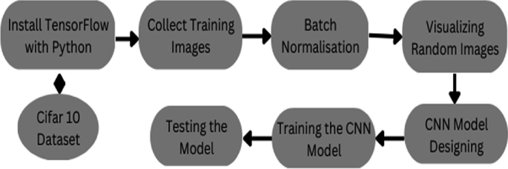
MODELLING
Using GAN
CNN
3/21/2024 Annual Review
9

Slide 10
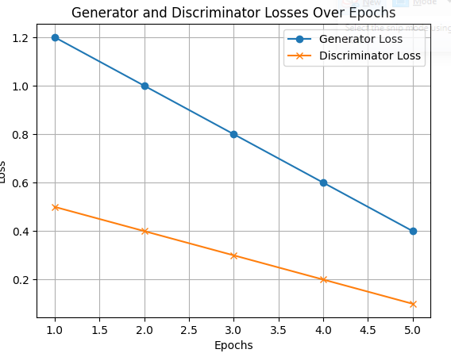
RESULT
This represents a notable improvement from previous epochs, suggesting that the discriminator is becoming more proficient at distinguishing between real and fake images.These advancements signify ongoing refinement in the training process, with both networks making strides towards optimizing their respective objectives--Generative Adversarial Network (GAN) model.
Demo Link
3/21/2024 Annual Review
10

